Slide 1
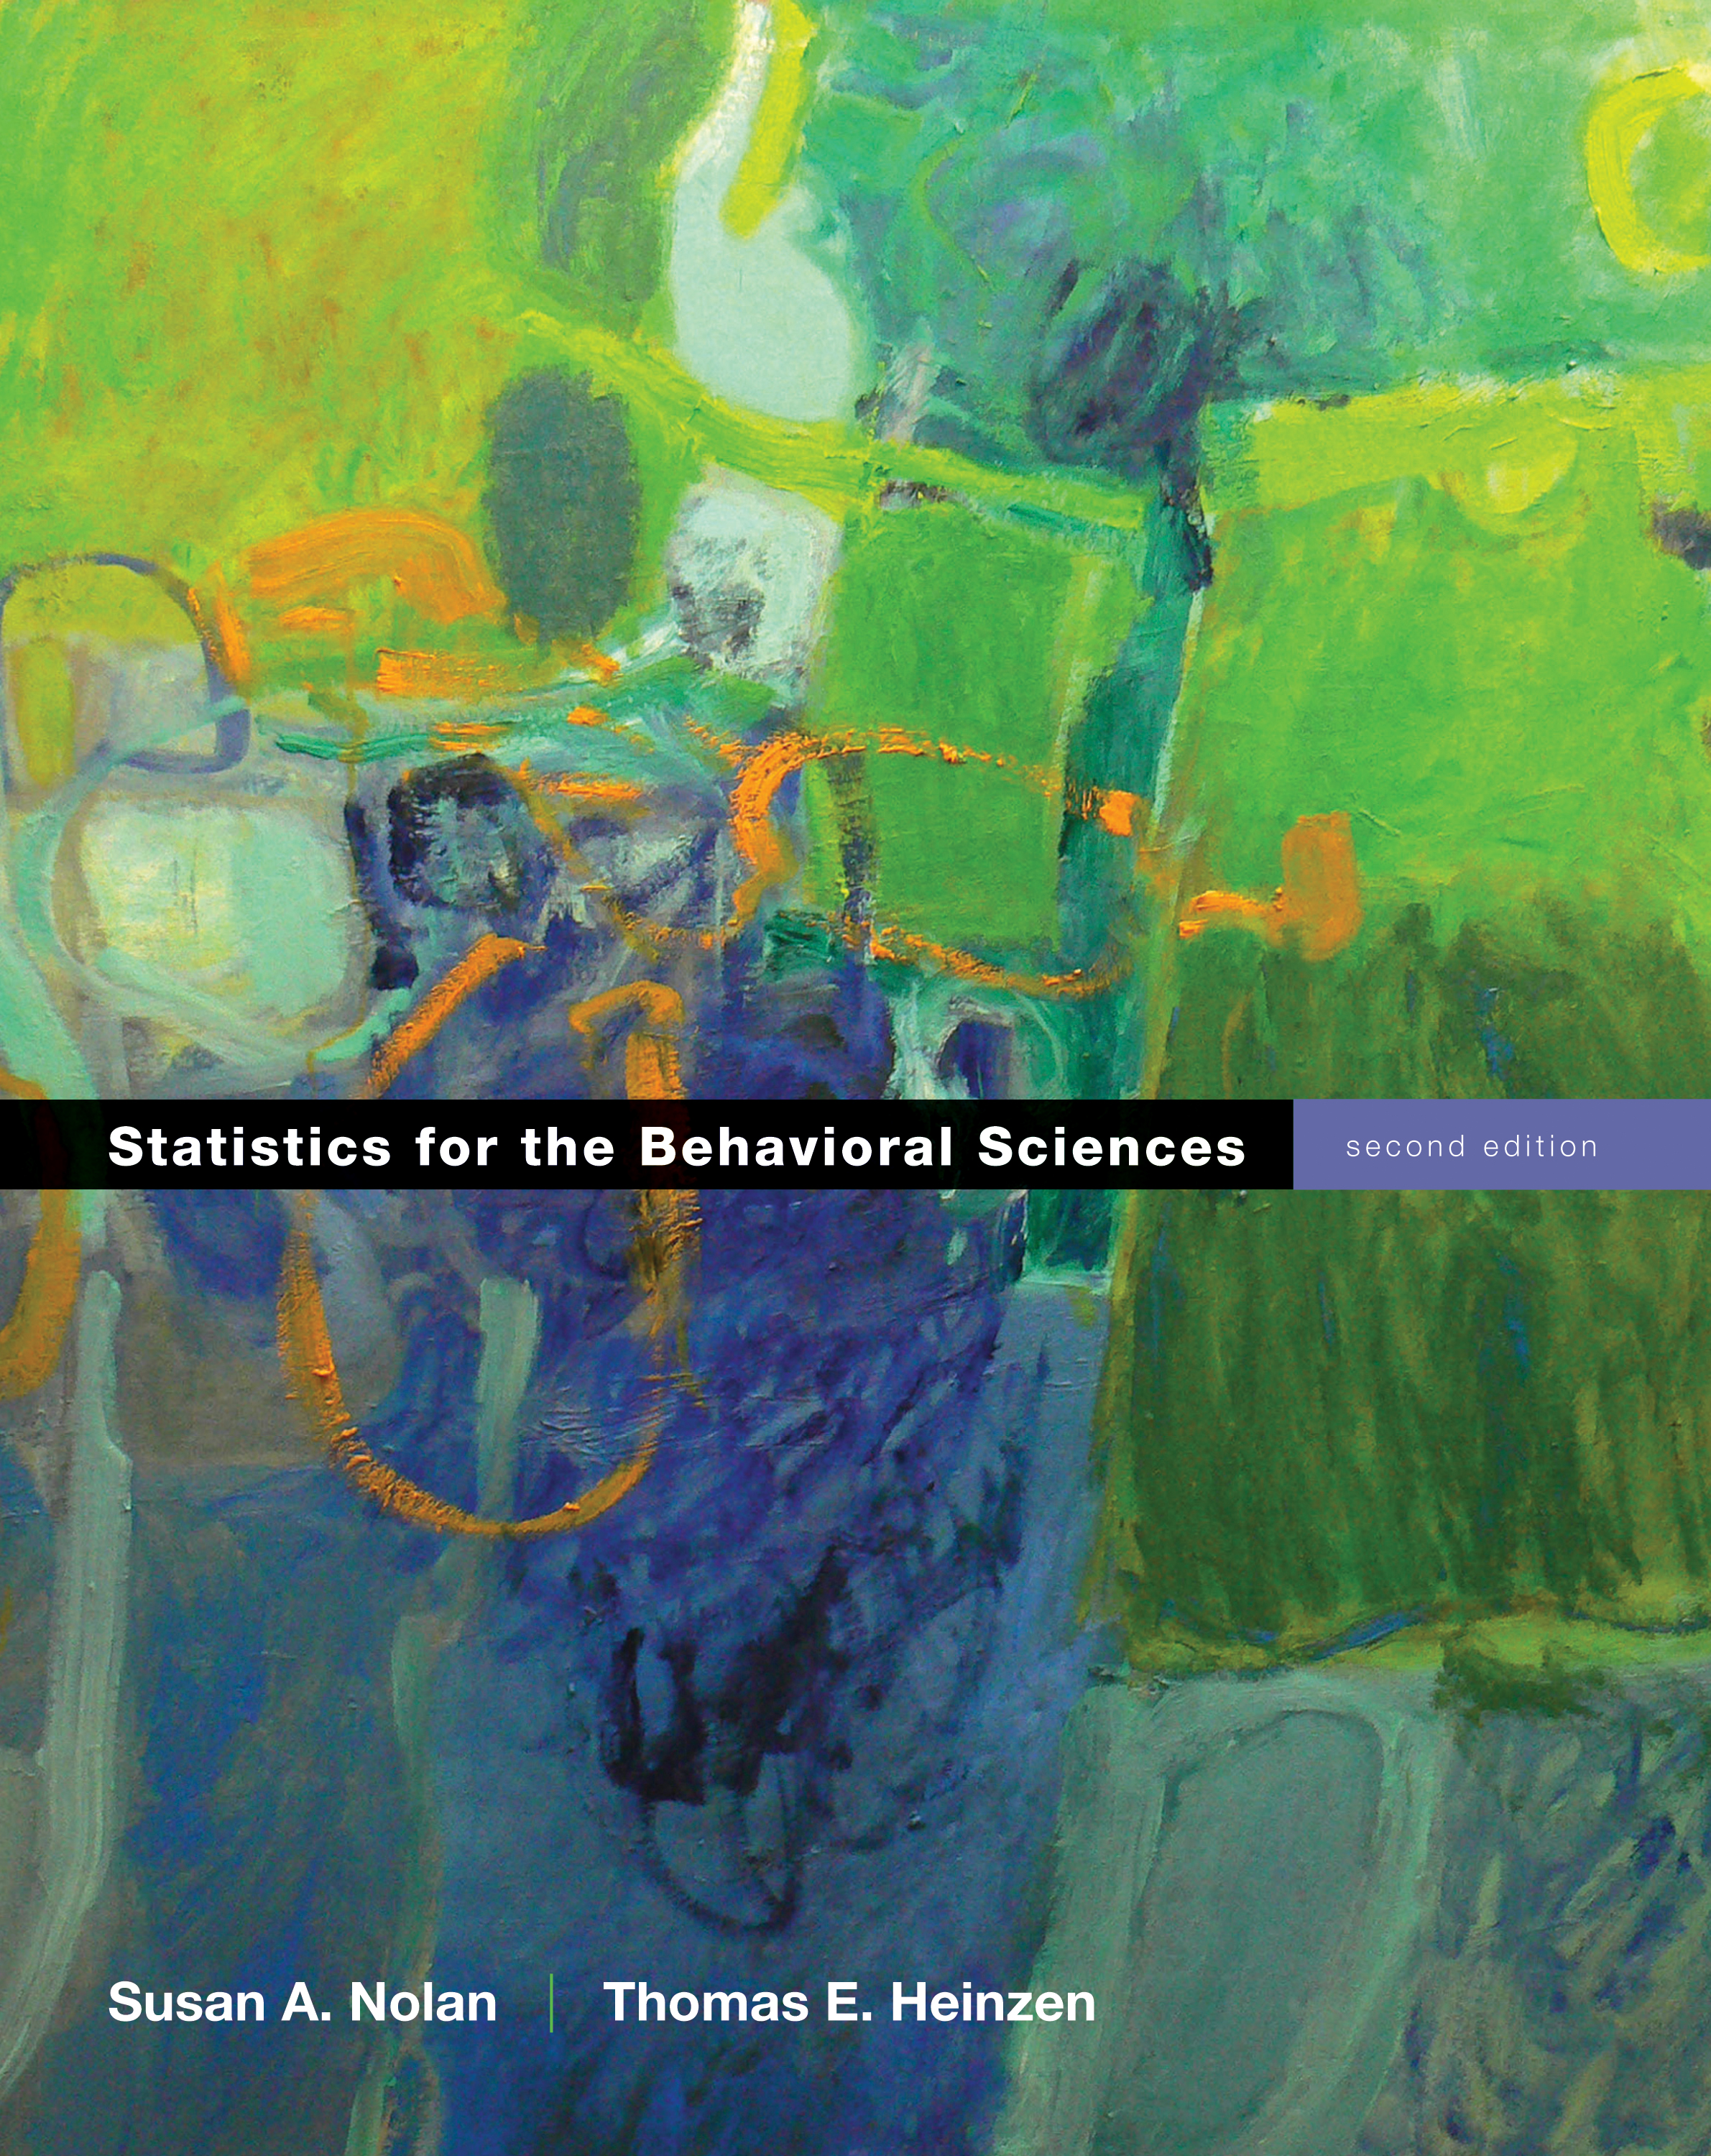
Sampling and Probability
Chapter 5

Slide 2
Sampling & Elections
Problems with predicting elections:
Sample sizes are too small
Samples are biased (also tied to that SD thing!)
Samples were not independent
http://www.fivethirtyeight.com

Slide 3
Samples and Their Populations
Decision making
The risks and rewards of sampling

Slide 4
Risks
1. The sample might not represent the larger population.
2. We might not know that the sample is misleading.
3. We might reach inaccurate conclusions.
4. We might make decisions based on this bad information.

Slide 5
Rewards
1. The sample represents the larger population.
2. We increase our level of confidence in our own findings.
3. We reach accurate conclusions at a very low cost.
4. We remain open-minded because we know samples can mislead us.
5. We make wiser decisions based on the available evidence.

Slide 6
How to Sample
So how do we get these people?
Random samples
Convenience samples

Slide 7
Random Sample
Every member of the populations has an equal chance of being selected into the study.
Random samples are almost never used in the social sciences – hard to access to the whole population from which to select the sample.
And ethics and stuff.

Slide 8
Variation & Random Sampling
Convenience sample
Is one that uses participants who are readily available
Intro to Psyc participant pool
Why would you use this instead of full random sampling?

Slide 9
Limitation of Convenience Sampling
Generalizability – the ability to apply findings from one sample or in one context to other samples or contexts (external validity)
Can be improved with replication

Slide 10
Replication
Replicability crisis?
Generally, replications are duplication of results but with different context or sample characteristics
Replication Q:
Which are you more likely to believe:
An effect that replicates 9/10 times
An effect that replicates 25/50 times

Slide 11
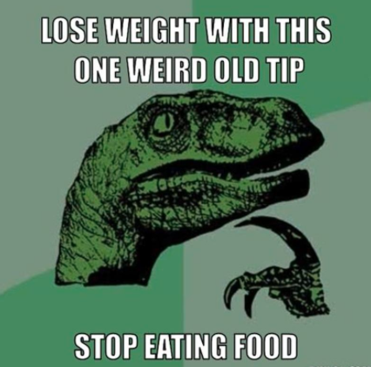
Biased Sampling
Testimonials as Evidence? Use a volunteer sample of one person.
Convenience sampling where participants actively choose to be in the study

Slide 12
Check Your Learning
Was random assignment used? Could it have been?
A health psychologist examined whether postoperative recovery time was less among patients who received counseling prior to surgery than among those who did not.
A clinical psychologist studied whether people with diagnosed personality disorder were more likely to miss therapy appointments than were people without diagnosed personality disorders.

Slide 13
Random Assignment
All participants have an equal chance of being assigned to any level of the independent variable.
Random selection is almost never used, but random assignment is frequently used.

Slide 14
Sampling Probability Quiz
Do you agree?
“That woman has been playing that slot machine without success for two hours and she just quit; let’s play that one—it’s going to pay off soon.”
“My next-door neighbor has three boys and she’s pregnant again. This one is bound to be a girl.”

Slide 15
Probability
Confirmation bias – only attending to evidence that confirms our beliefs (which means ignoring disconfirming evidence)

Slide 16
Probability
Illusory correlation – believing an association between variables exists when it does not
Stereotypes?

Slide 17
Probability
Probability – likelihood of an event occurring out of all possible events
So what’s the probability of lefties?
What about our class?

Slide 18
Probability
Subjective interpretations (personal probability)
Your judgment of a likelihood
Objective interpretations (expected relative frequency probability)
The likelihood after testing many times

Slide 19
Probability
Trials – all the times you test something
Outcome – result of the trial
Success – particular outcome we are looking for
So, Amanda Knox as a 2/3 probability of being convicted

Slide 20
Calculating Probability
Step 1. Determine the total number of trials.
Step 2. Determine the number of these trails that are “successful” outcomes.
Step 3. Divide the number of successful outcomes by the number of trials.

Slide 21
Independence
Outcome of each trial is unrelated to outcome of previous trials.
Gambler’s fallacy is the opposite of independence:
The mistaken notion that the probability of a particular event changes with a long string of the same event.

Slide 22
Inferential Statistics
Use rules of probability to test hypotheses
So it’s call Hypothesis Testing
Use probability to make decisions
Although … not quite like you’d think.

Slide 23
Developing Hypotheses
Usually you start by thinking about your variables/levels
Control group
Experimental group
Or two variables you want to correlate

Slide 24
Developing Hypotheses
Then you frame those groups into TWO hypotheses
Null - There is no difference between levels, no relationship between variables
Research - There is a difference between levels, relationship between variables.
Why two hypotheses?
Sometimes you predict a direction, more on that later.

Slide 25
Making a Decision about Hypotheses
Reject the null hypothesis
Conclude that you found a difference (statistically significant)
Fail to reject the null hypothesis
Conclude that you did not find a difference (not statistically significant)
Why is it all about the null?!
NHST – Null hypothesis significance testing

Slide 26
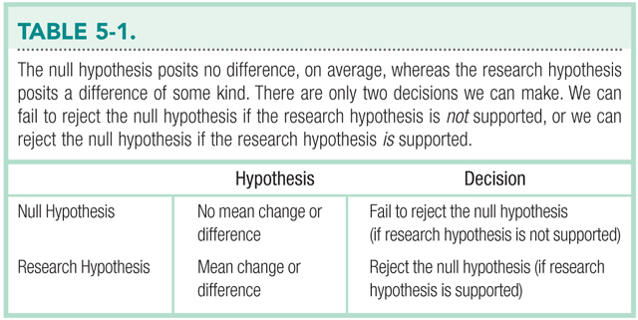

Slide 27
An example
We wanted to know if attendance in PASS sessions would lower the DFW rate for traditionally hard courses.

Slide 28
An example
IV: Pass session attendance
Levels: Yes or No
NOIR: Nominal
DV: DFW rate in percentage
NOIR: Ratio

Slide 29
An example
Null hypothesis:
There is not difference in DFW rates between people who attended and did not attend PASS sessions.
OR
No sessions DFW = Sessions DFW

Slide 30
An example
Research hypothesis
There is a difference in DFW rates for those who attended sessions versus not.
OR
No sessions DFW /= sessions DFW

Slide 31
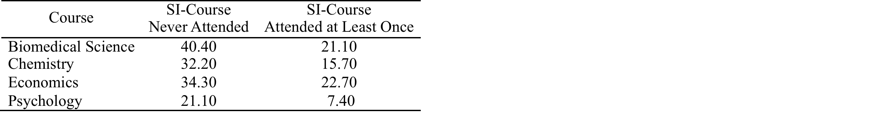
An example

Slide 32
An Example
If we reject the null
We are supporting the idea that there is a difference (mainly a decrease) in DFW rates for those who attended PASS sessions.

Slide 33
An Example
If we fail to reject the null
We have failed to find a difference between DFW rates … did not support the research hypothesis. That may be due to:
This sample
There really isn’t a difference
Chance

Slide 34
What has this got to do with probability?
We determine if we are going to reject or fail to reject by calculating the probability of the null hypothesis.
Remember it’s call Null Hypothesis Significance Testing, so we test if the null is true.
So we want SMALL probabilities.

Slide 35
Type I and Type II Errors
Statistical Inferences Can Be Wrong
Type I errors (alpha)
Sins of commission – rejecting the null hypothesis when it is true
Saying that something happened when it didn’t
Type II errors (beta)
Sins of omission – failing to reject the null hypothesis when it is false
Saying that nothing happened when it did

Slide 36
Prevalence of Type I Errors
Positive outcomes are more likely to be reported than null results.
Remember the study you picked on which was more likely?
Ways to test the rates of Type I errors, as well as the “file drawer problem”

